Slide 1
William Stallings
Data and Computer Communications
Chapter 13
Local Area Network
Technology

Slide 2
LAN Applications (1)
Personal computer LANs
  Low cost
  Limited data rate
Back end networks and storage area networks
  Interconnecting large systems (mainframes and large storage devices)
    High data rate
    High speed interface
    Distributed access
    Limited distance
    Limited number of devices

Slide 3
LAN Applications (2)
High speed office networks
  Desktop image processing
  High capacity local storage
Backbone LANs
  Interconnect low speed local LANs
  Reliability
  Capacity
  Cost

Slide 4
LAN Architecture
Protocol architecture
Topologies
Media access control
Logical Link Control

Slide 5
Protocol Architecture
Lower layers of OSI model
IEEE 802 reference model
Physical
Logical link control (LLC)
Media access control (MAC)

Slide 6
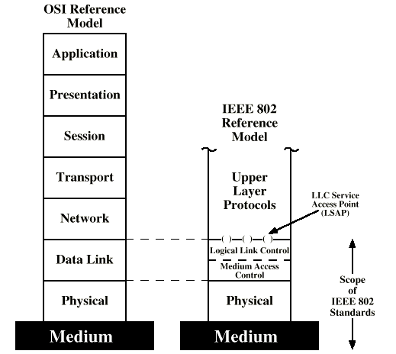
IEEE 802 v OSI

Slide 7
802 Layers -
Physical
Encoding/decoding
Preamble generation/removal
Bit transmission/reception
Transmission medium and topology

Slide 8
802 Layers -
Logical Link Control
Interface to higher levels
Flow and error control

Slide 9
802 Layers -
Media Access Control
Assembly of data into frame with address and error detection fields
Disassembly of frame
  Address recognition
  Error detection
Govern access to transmission medium
  Not found in traditional layer 2 data link control
For the same LLC, several MAC options may be available

Slide 10
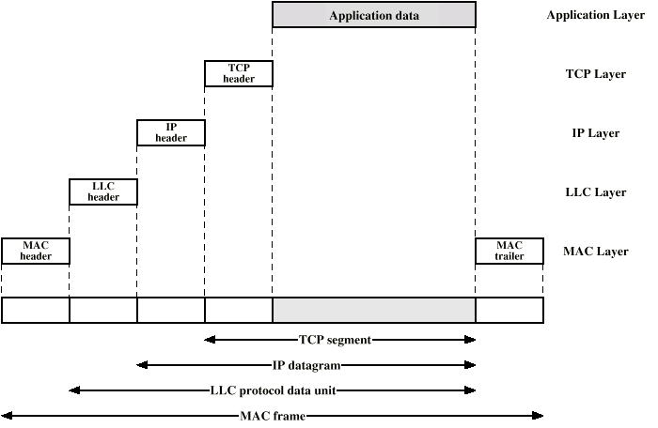
LAN Protocols in Context

Slide 11
Topologies
Tree
Bus
  Special case of tree
    One trunk, no branches
Ring
Star

Slide 12
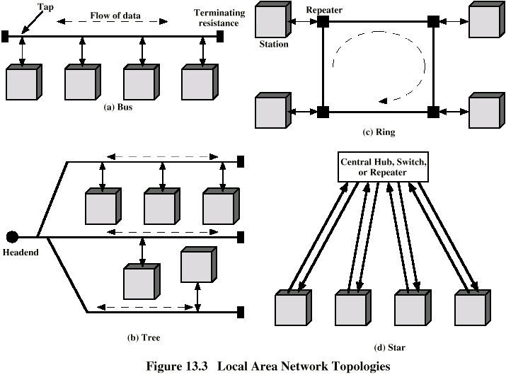
LAN Topologies

Slide 13
Bus and Tree
Multipoint medium
Transmission propagates throughout medium
Heard by all stations
  Need to identify target station
    Each station has unique address
Full duplex connection between station and tap
  Allows for transmission and reception
Need to regulate transmission
  To avoid collisions
  To avoid hogging
    Data in small blocks - frames
Terminator absorbs frames at end of medium

Slide 14
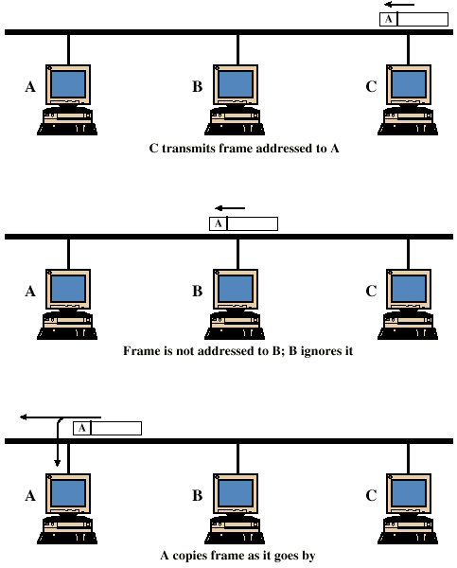
Frame Transmission - Bus LAN

Slide 15
Ring Topology
Repeaters joined by point to point links in closed loop
  Receive data on one link and retransmit on another
  Links unidirectional
  Stations attach to repeaters
Data in frames
  Circulate past all stations
  Destination recognizes address and copies frame
  Frame circulates back to source where it is removed
Media access control determines when station can insert frame

Slide 16
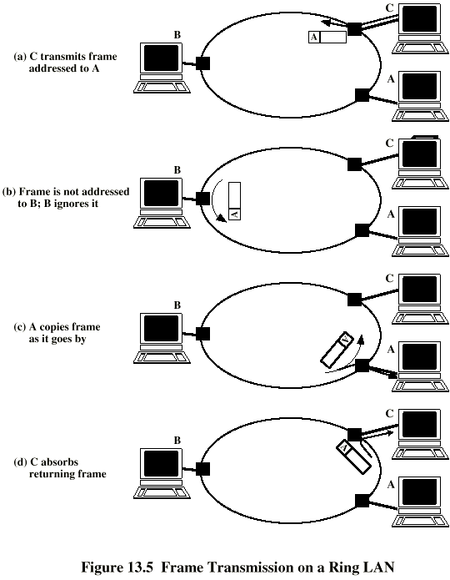
Frame
Transmission
Ring LAN

Slide 17
Star Topology
Each station connected directly to central node
  Usually via two point to point links
Central node can broadcast
  Physical star, logical bus
  Only one station can transmit at a time
Central node can act as frame switch

Slide 18
Media Access Control
Where
  Central
    Greater control
    Simple access logic at station
    Avoids problems of co-ordination
    Single point of failure
    Potential bottleneck
  Distributed
How
  Synchronous
    Specific capacity dedicated to connection
  Asynchronous
    In response to demand

Slide 19
Asynchronous Systems
Round robin
  Good if many stations have data to transmit over extended period
Reservation
  Good for stream traffic
Contention
  Good for bursty traffic
  All stations contend for time
  Distributed
  Simple to implement
  Efficient under moderate load
  Tend to collapse under heavy load

Slide 20
MAC Frame Format
MAC layer receives data from LLC layer
MAC control
Destination MAC address
Source MAC address
LLS
CRC
MAC layer detects errors and discards frames
LLC optionally retransmits unsuccessful frames

Slide 21
Logical Link Control
Transmission of link level PDUs between two stations
Must support multiaccess, shared medium
Relieved of some link access details by MAC layer
Addressing involves specifying source and destination LLC users
  Referred to as service access points (SAP)
  Typically higher level protocol

Slide 22
LLC Services
Based on HDLC
Unacknowledged connectionless service
Connection mode service
Acknowledged connectionless service

Slide 23
LLC Protocol
Modeled after HDLC
Asynchronous balanced mode to support connection mode LLC service (type 2 operation)
Unnumbered information PDUs to support Acknowledged connectionless service (type 1)
Multiplexing using LSAPs

Slide 24
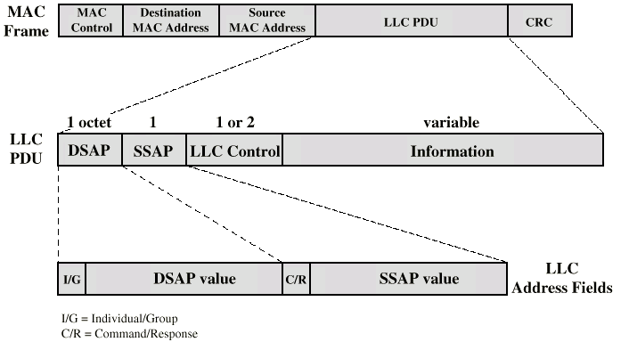
Typical Frame Format

Slide 25
Bus LANs
Signal balancing
  Signal must be strong enough to meet receiver’s minimum signal strength requirements
  Give adequate signal to noise ration
  Not so strong that it overloads transmitter
  Must satisfy these for all combinations of sending and receiving station on bus
  Usual to divide network into small segments
  Link segments with amplifies or repeaters

Slide 26
Transmission Media
Twisted pair
  Not practical in shared bus at higher data rates
Baseband coaxial cable
  Used by Ethernet
Broadband coaxial cable
  Included in 802.3 specification but no longer made
Optical fiber
  Expensive
  Difficulty with availability
  Not used
Few new installations
  Replaced by star based twisted pair and optical fiber

Slide 27
Baseband Coaxial Cable
Uses digital signaling
Manchester or Differential Manchester encoding
Entire frequency spectrum of cable used
Single channel on cable
Bi-directional
Few kilometer range
Ethernet (basis for 802.3) at 10Mbps
50 ohm cable

Slide 28
10Base5
Ethernet and 802.3 originally used 0.4 inch diameter cable at 10Mbps
Max cable length 500m
Distance between taps a multiple of 2.5m
  Ensures that reflections from taps do not add in phase
Max 100 taps
10Base5

Slide 29
10Base2
Cheapernet
0.25 inch cable
  More flexible
  Easier to bring to workstation
  Cheaper electronics
  Greater attenuation
  Lower noise resistance
  Fewer taps (30)
  Shorter distance (185m)

Slide 30
Repeaters
Transmits in both directions
Joins two segments of cable
No buffering
No logical isolation of segments
If two stations on different segments send at the same time, packets will collide
Only one path of segments and repeaters between any two stations

Slide 31
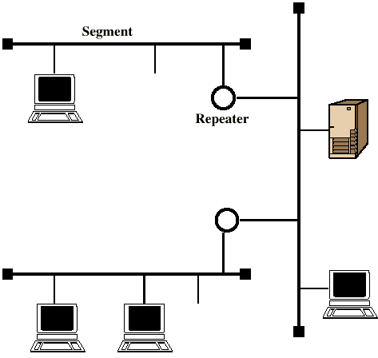
Baseband Configuration

Slide 32
Ring LANs
Each repeater connects to two others via unidirectional transmission links
Single closed path
Data transferred bit by bit from one repeater to the next
Repeater regenerates and retransmits each bit
Repeater performs data insertion, data reception, data removal
Repeater acts as attachment point
Packet removed by transmitter after one trip round ring

Slide 33
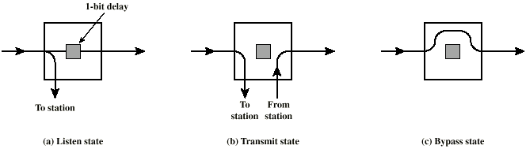
Ring Repeater States

Slide 34
Listen State Functions
Scan passing bit stream for patterns
  Address of attached station
  Token permission to transmit
Copy incoming bit and send to attached station
  Whilst forwarding each bit
Modify bit as it passes
  e.g. to indicate a packet has been copied (ACK)

Slide 35
Transmit State Functions
Station has data
Repeater has permission
May receive incoming bits
  If ring bit length shorter than packet
    Pass back to station for checking (ACK)
  May be more than one packet on ring
    Buffer for retransmission later

Slide 36
Bypass State
Signals propagate past repeater with no delay (other than propagation delay)
Partial solution to reliability problem (see later)
Improved performance

Slide 37
Ring Media
Twisted pair
Baseband coaxial
Fiber optic
Not broadband coaxial
  Would have to receive and transmit on multiple channels, asynchronously

Slide 38
Timing Jitter
Clocking included with signal
  e.g. differential Manchester encoding
  Clock recovered by repeaters
    To know when to sample signal and recover bits
    Use clocking for retransmission
  Clock recovery deviates from midbit transmission randomly
    Noise
    Imperfections in circuitry
Retransmission without distortion but with timing error
Cumulative effect is that bit length varies
Limits number of repeaters on ring

Slide 39
Solving Timing Jitter Limitations
Repeater uses phase locked loop
  Minimize deviation from one bit to the next
Use buffer at one or more repeaters
  Hold a certain number of bits
  Expand and contract to keep bit length of ring constant
Significant increase in maximum ring size

Slide 40
Potential Ring Problems
Break in any link disables network
Repeater failure disables network
Installation of new repeater to attach new station requires identification of two topologically adjacent repeaters
Timing jitter
Method of removing circulating packets required
  With backup in case of errors
Mostly solved with star-ring architecture

Slide 41
Star Ring Architecture
Feed all inter-repeater links to single site
  Concentrator
  Provides central access to signal on every link
  Easier to find faults
  Can launch message into ring and see how far it gets
  Faulty segment can be disconnected and repaired later
  New repeater can be added easily
  Bypass relay can be moved to concentrator
  Can lead to long cable runs
Can connect multiple rings using bridges

Slide 42
Star LANs
Use unshielded twisted pair wire (telephone)
  Minimal installation cost
    May already be an installed base
    All locations in building covered by existing installation
Attach to a central active hub
Two links
  Transmit and receive
Hub repeats incoming signal on all outgoing lines
Link lengths limited to about 100m
  Fiber optic - up to 500m
Logical bus - with collisions

Slide 43
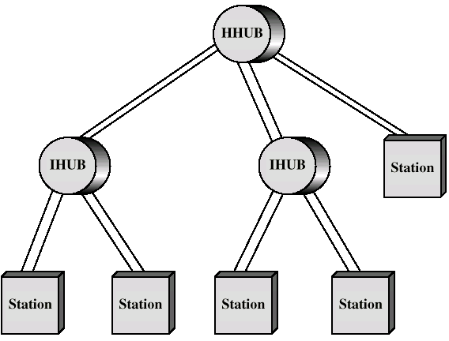
Two Level Star Topology

Slide 44
Hubs and Switches
Shared medium hub
  Central hub
  Hub retransmits incoming signal to all outgoing lines
  Only one station can transmit at a time
  With a 10Mbps LAN, total capacity is 10Mbps
Switched LAN hub
  Hub acts as switch
  Incoming frame switches to appropriate outgoing line
  Unused lines can also be used to switch other traffic
  With two pairs of lines in use, overall capacity is now 20Mbps

Slide 45
Switched Hubs
No change to software or hardware of devices
Each device has dedicated capacity
Scales well
Store and forward switch
  Accept input, buffer it briefly, then output
Cut through switch
  Take advantage of the destination address being at the start of the frame
  Begin repeating incoming frame onto output line as soon as address recognized
  May propagate some bad frames

Slide 46
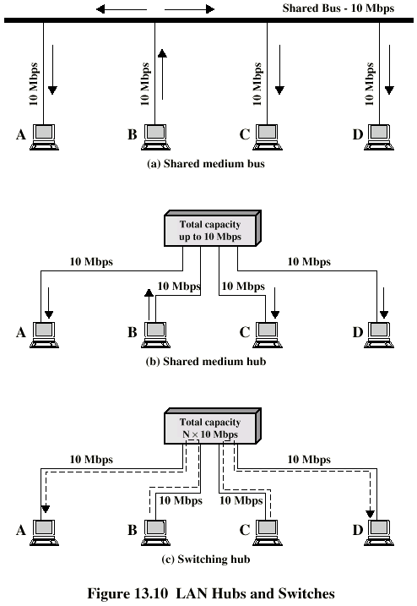
Hubs and
Switches (diag)

Slide 47
Wireless LANs
Mobility
Flexibility
Hard to wire areas
Reduced cost of wireless systems
Improved performance of wireless systems

Slide 48
Wireless LAN Applications
LAN Extension
Cross building interconnection
Nomadic access
Ad hoc networks

Slide 49
LAN Extension
Buildings with large open areas
  Manufacturing plants
  Warehouses
Historical buildings
Small offices
May be mixed with fixed wiring system

Slide 50
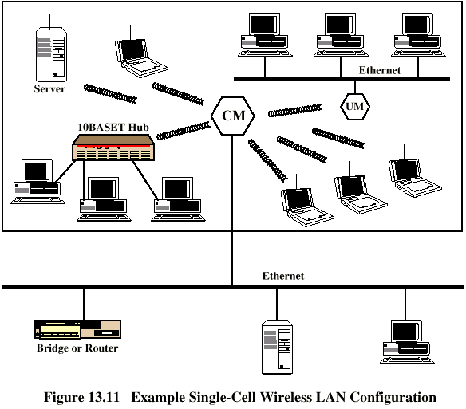
Single Cell Wireless LAN

Slide 51
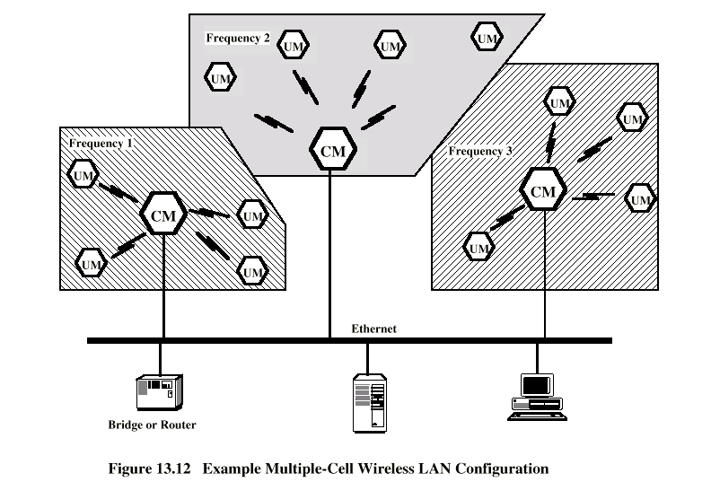
Multi Cell Wireless LAN

Slide 52
Cross Building Interconnection
Point to point wireless link between buildings
Typically connecting bridges or routers
Used where cable connection not possible
  e.g. across a street

Slide 53
Nomadic Access
Mobile data terminal
  e.g. laptop
Transfer of data from laptop to server
Campus or cluster of buildings

Slide 54
Ad Hoc Networking
Peer to peer
Temporary
e.g. conference

Slide 55
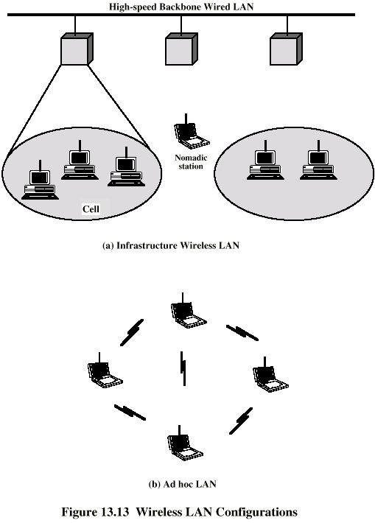
Wireless LAN Configurations

Slide 56
Wireless LAN Requirements
Throughput
Number of nodes
Connection to backbone
Service area
Battery power consumption
Transmission robustness and security
Collocated network operation
License free operation
Handoff/roaming
Dynamic configuration

Slide 57
Wireless LAN Technology
Infrared (IR) LANs
Spread spectrum LANs
Narrow band microwave

Slide 58
Bridges
Ability to expand beyond single LAN
Provide interconnection to other LANs/WANs
Use Bridge or router
Bridge is simpler
  Connects similar LANs
  Identical protocols for physical and link layers
  Minimal processing
Router more general purpose
  Interconnect various LANs and WANs
  see later

Slide 59
Why Bridge?
Reliability
Performance
Security
Geography

Slide 60
Functions of a Bridge
Read all frames transmitted on one LAN and accept those address to any station on the other LAN
Using MAC protocol for second LAN, retransmit each frame
Do the same the other way round

Slide 61
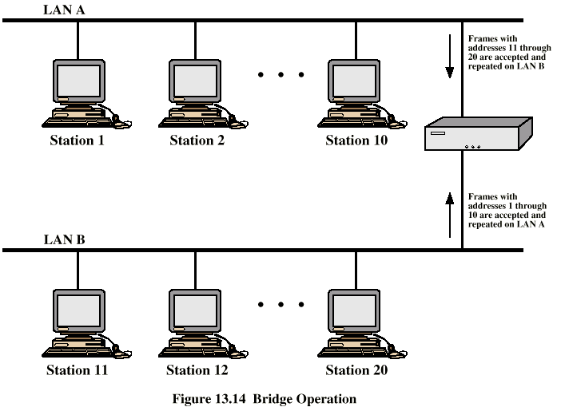
Bridge Operation

Slide 62
Bridge Design Aspects
No modification to content or format of frame
No encapsulation
Exact bitwise copy of frame
Minimal buffering to meet peak demand
Contains routing and address intelligence
  Must be able to tell which frames to pass
  May be more than one bridge to cross
May connect more than two LANs
Bridging is transparent to stations
  Appears to all stations on multiple LANs as if they are on one single LAN

Slide 63
Bridge Protocol Architecture
IEEE 802.1D
MAC level
  Station address is at this level
Bridge does not need LLC layer
  It is relaying MAC frames
Can pass frame over external comms system
  e.g. WAN link
  Capture frame
  Encapsulate it
  Forward it across link
  Remove encapsulation and forward over LAN link

Slide 64
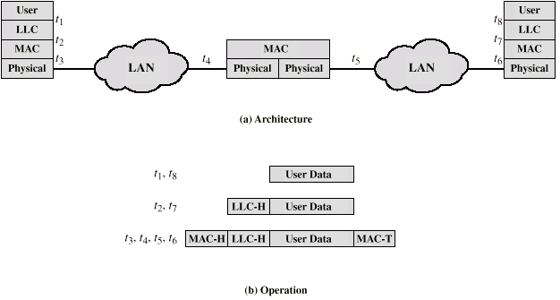
Connection of Two LANs

Slide 65
Fixed Routing
Complex large LANs need alternative routes
  Load balancing
  Fault tolerance
Bridge must decide whether to forward frame
Bridge must decide which LAN to forward frame on
Routing selected for each source-destination pair of LANs
  Done in configuration
  Usually least hop route
  Only changed when topology changes

Slide 66
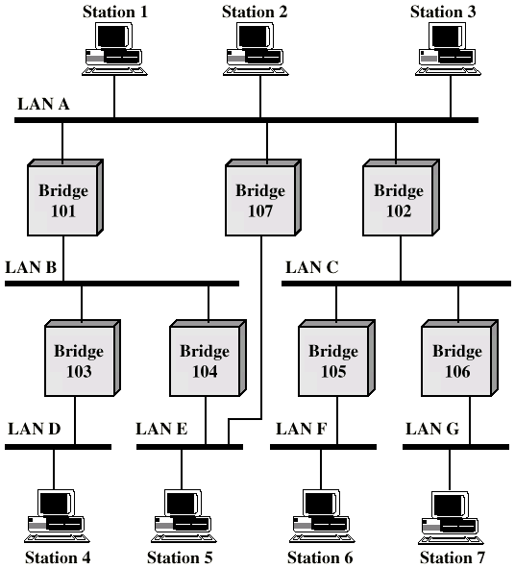
Multiple LANs

Slide 67
Spanning Tree
Bridge automatically develops routing table
Automatically update in response to changes
Frame forwarding
Address learning
Loop resolution

Slide 68
Frame forwarding
Maintain forwarding database for each port
  List station addresses reached through each port
For a frame arriving on port X:
  Search forwarding database to see if MAC address is listed for any port except X
  If address not found, forward to all ports except X
  If address listed for port Y, check port Y for blocking or forwarding state
    Blocking prevents port from receiving or transmitting
  If not blocked, transmit frame through port Y

Slide 69
Address Learning
Can preload forwarding database
Can be learned
When frame arrives at port X, it has come form the LAN attached to port X
Use the source address to update forwarding database for port X to include that address
Timer on each entry in database
Each time frame arrives, source address checked against forwarding database

Slide 70
Spanning Tree Algorithm
Address learning works for tree layout
  i.e. no closed loops
For any connected graph there is a spanning tree that maintains connectivity but contains no closed loops
Each bridge assigned unique identifier
Exchange between bridges to establish spanning tree

Slide 71
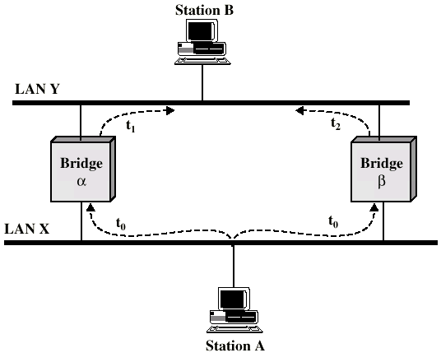
Loop of Bridges

Slide 72
Required Reading
Stallings chapter 13
Loads of info on the Web

